Slide 1

Window
See where your style takes you
High Fidelity Design – Midway
Max Freundlich, Kristen Law, Elisa Lupin-Jimenez

Slide 2
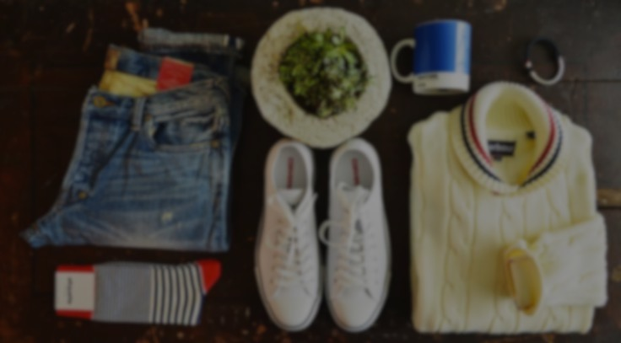
Problem
Shoppers want more freedom
Notes:
Problem: people often go out shopping to find something specifically or get inspired but instead find themselves in a dead-end when they don’t know where to go or what else is out there

Slide 3

Solution
AR Mannequin wearing the clothes in store
Notes:
Solution: current mixed reality technologies to make a mannequin appear in the store front that is wearing clothes that the store currently holds.
Users = guide our users along their shopping adventure and hopefully give them a “window” of opportunity to discover something new about themselves and the world around them

Slide 4

Heuristic Evaluation
Revised Design
Prototype Status
Live Demo
Notes:
click

Slide 5
Heuristic Evaluation
Revised Design
Prototype Status
Live Demo
Notes:
click

Slide 6

Heuristic Evaluation Overview
37 Heuristic Violations
11 are Severity Three
3 are Severity Four
Majority are User Control Issues

Slide 7
Big Problems
[H2-1] Inability to see whole clothing collection
[H2-2] Closet Remains Unclear
Notes:
to browse through a store’s virtual inventory
using our application’s main functionality,
highlight any major UI flaws navigating through the basic screens of the application

Slide 8
Big Problems
[H2-3] Editing Preferences Mid-Use
[H2-3] Friend Sharing Limited
Notes:
to browse through a store’s virtual inventory
using our application’s main functionality,
highlight any major UI flaws navigating through the basic screens of the application

Slide 9
Other problems
[H2-3] No ability to toggle clothes
[H2-10] Need user tips
[H2-5] Better quick start
[H2-4] Access to online store
Notes:
to browse through a store’s virtual inventory
using our application’s main functionality,
highlight any major UI flaws navigating through the basic screens of the application

Slide 10
Heuristic Evaluation
Revised Design
Prototype Status
Live Demo
Notes:
click

Slide 11
Heuristic Evaluation
Revised Design
Prototype Status
Live Demo
Notes:
click

Slide 12
No more need to Log In

Slide 13
One-Time Profile Creation

Slide 14
Quick Filter Access
Notes:
to find an item for someone of the opposite gender in a specific size, then send that item to them virtually
use our gender filtering options to find an item
use our sharing option

Slide 15
Share Via Text
Notes:
to find an item for someone of the opposite gender in a specific size, then send that item to them virtually
use our gender filtering options to find an item
use our sharing option

Slide 16
Heuristic Evaluation
Revised Design
Prototype Status
Live Demo
Notes:
click

Slide 17
Heuristic Evaluation
Revised Design
Prototype Status
Live Demo
Notes:
click

Slide 18
Tools in Use
Xcode IDE
ARToolKit SDK
Maya 2016
Notes:
Xcode in objective C

Slide 19
Implemented Features
Scan a store name
Render 3D clothing
Swipe navigation
Filter Options
Task 1: Browse a store selection

Slide 20

Unimplemented Features
Swipe on individual items
Greater variety of 3D assets
“The Plan”: go by task
Task 2: Filtering Selection
Task 3: Share with Friends

Slide 21
Wizard of Oz Hacks
3D clothes are not related to a specific store
Only reading one store currently (“GAP”)

Slide 22
Challenges and Questions
Unsure on how to use Tesseract (OCR for scan screen)
Training marker detector

Slide 23
Demo

Slide 24
Heuristic Evaluation
Revised Design
Prototype Status
Live Demo
Notes:
click

Slide 25
Tough but Thought-Provoking
Focus on Simplicity
AR Functionality Mostly Complete
Task 1 Complete, Other Tasks Impending
Notes:
click

Slide 26

Questions?
Notes:
- Thank you for your time!

